Slide 1
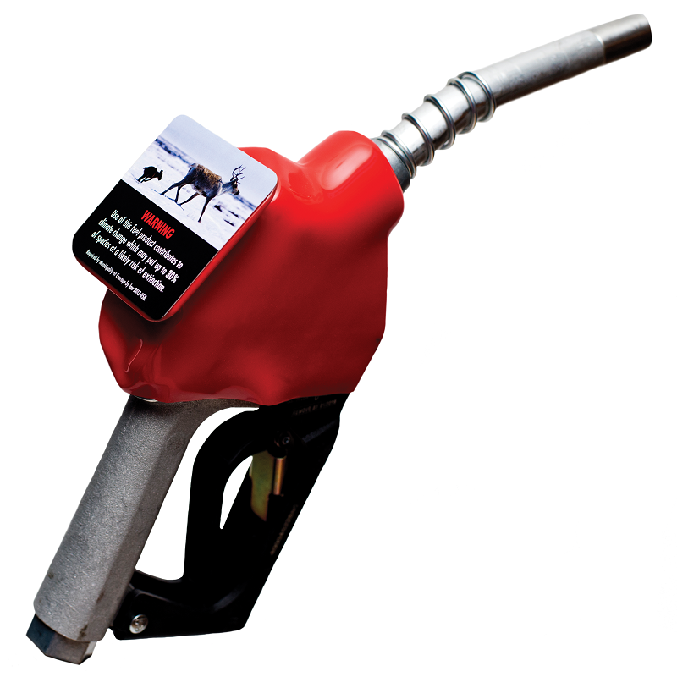
CAN A
SIMPLE STICKER
HELP US ACT ON
CLIMATE CHANGE?
CLIMATE CHANGE LABELS ON GAS PUMPS
Historic North American vote: On January 26, 2015, West Vancouver unanimously passed a resolution “that all vendors of retail petroleum products in Canada be legislated to provide warning labels on all pump handles.” It has since been endorsed by over 50 communities in Canada. The concept is also being pursued by several cities in the United States.
Join Robert Shirkey, lawyer and creator of the campaign to get climate change labels on gas pump nozzles as he discusses the psychology, economics, and law behind the idea. Robert has given lectures across North America and is a recognized global authority on the subject. The concept has been endorsed by some of the world’s leading experts in climate science and policy.
APRIL 17th, 2015, 8:40 a.m.
Dunbarton High School
655 Sheppard Ave., Pickering
>> communications@ourhorizon.org
www.ourhorizon.org

